Slide 1
WEB APPLICATION FOR LOCATION DIRECTORY
Presented By :
BALAJI J
(Reg.no : 20Y005)
Internal Guide: External Guide:
Prof. N.Murali, V.Prabhu,
Assistant Professor, Technical Lead,
Department Of Computer Application, AstroWeb Solutions,
Thiagarajar College Of Engineering Simmakkal,
Madurai. Madurai.

Slide 2
SYNOPSIS
About the organization
Abstract
Introduction
Proposed System
Modules
Gantt Chart and Architectural Design
ER Diagram, DFD, Use Case Diagram
Technologies Used
Expected Outcomes
References

Slide 3
ABOUT THE ORGANIZATION
AstroWebSolution is a software company in Madurai that expertise in custom design and apps development services. It provides Services like
Custom Design
Web & Mobile App Development
Digital Transformation
IT Consultancy
Digital Marketing
Mission
Our mission is to provide innovative software solutions for excellence and enterprise compliance.
Vision
Our vision is to become business first choice when it comes to software development and maintenance. To accomplish this, we always try to exceed our client’s expectations. AstroWebSolution strives to build lasting partnerships and ensures client satisfaction.

Slide 4
abstract
The project is to be implemented on Madurai city in which it helps the user to find location based on various category. The goal of the project is to explore city with a Categorised web application. The prototype implemented includes basic functionalities of city guide such as showing a map, locating points of interest (POIs) on a map, locating location of a user, retrieving information of POIs, add reviews about POIs, plan a tour, support communication (e.g. phone, short message), show route direction to POIs, add reminder, and choose different kinds of POIs to show on map. Directories contain a large number of listings under different categories. It provide tools like searching, filtering, pictures, location information with maps, places information, contact details, and more. It is community driven and built on user generated content.

Slide 5
Introduction
This project acts as an important role in helping people to locate to their places inside a city and promote their business. The project directory is developed so that users can view the detailed information about the particular city. The users are register by providing details such as Name, Mail id. The project also has a login page where the registered user can login.
User can explore popular places as categorised lists like tourist places, restaurant & residency, jewellery, banking and finance, automobile, shops and they can also promote their shops using ads. Thus this application helps to select the location they need to explore in a efficient manner .The main aim of developing this application is to reduce the time and to give a accurate location in a city. Thus this application provides the required information for quicker decision making. To incorporate all these, a comparative study was done on websites such as Google Maps, Bing Maps, MapQuest etc. based on standard metrics

Slide 6
Proposed System
The motive of the proposed system is to provide the most accurate route and reliable path to the user. A suggestion-based system determines the similarity to users and produces a prediction for the user by taking the weighted average of all the ratings.
Therefore, we use some indexes which are appropriate to evaluate our approaches, such direction, Contact information, Working hours, reviews, updates. Then, we design several evaluation methods to analyse performance.
To predict a rating for an place, we calculate the overall review such as like, rating, comments. This enables users to find not only content items they are currently interested in, but also those in which they might become interested.
The current data of a place can be added easily and incrementally with an updated set of information.
It’s used for collecting and analysing a large amount of information on a user's behaviour, preference and predicting what users will like based on similarity to other users.

Slide 7
modules
Register / Login Module
Deals with login page UX design template. Register/ login account is about verification of user detail such as mail id and password. However, the authorization process of this is to give access in the form of approval to the user. So that after the approval the one can able to access the web app.
DASHBOARD
It deals with the details of how many listings of places have published and how many of them are in pending.
EDIT PROFILE & Change Password
It is used to update the Name, gmail and phone number and Used to change the current password to a new one.

Slide 8
MY LISTING
It is used to show all the places that are listed by the admin and the listings module can only be accessed by admin to proceed various activities like edit the information about a place, delete and publish a record.
SUBMIT LISTING
This Module needs information’s about a specific place like Title, Description, Logo, Address, Location, Latitude and Longitude for a place provided by using map, Business Details, Social Media Links, video and images about the place.Submit listing is the process that will upload the new places to this application. The admin uploads the places. The uploaded articles can view by all users. User can search based on the categories, then it will show all the uploaded places to user.

Slide 9
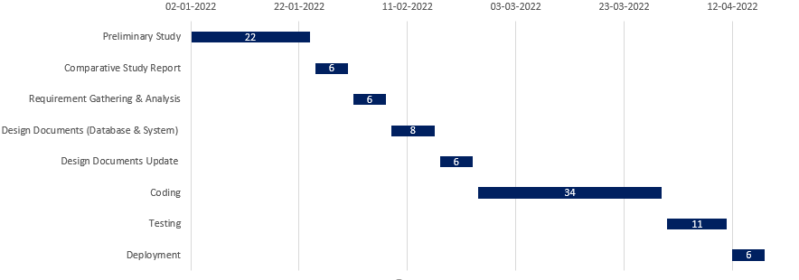
GANTT CHART

Slide 10
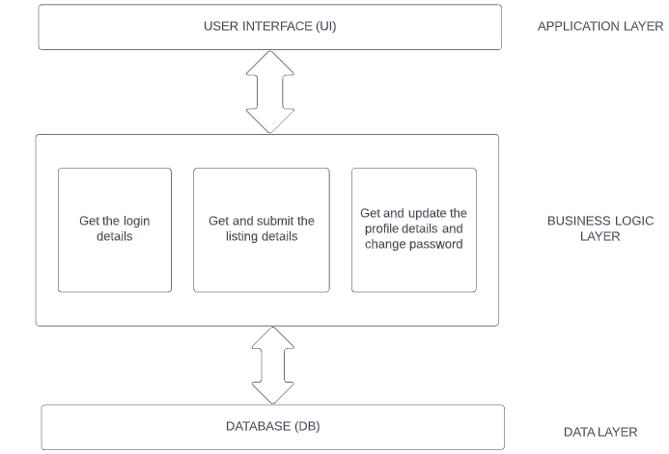
ARCHITECTURAL DESIGN

Slide 11
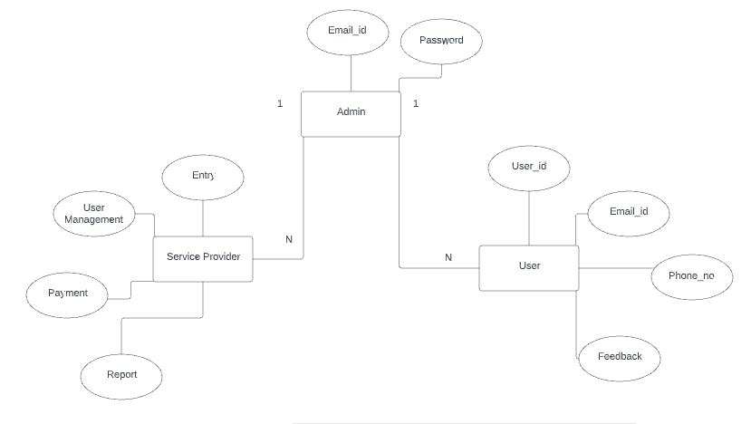
ER DIAGRAM

Slide 12
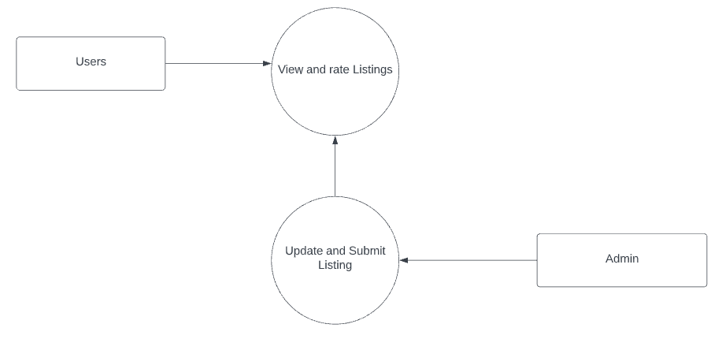
DFD LEVEL 0

Slide 13
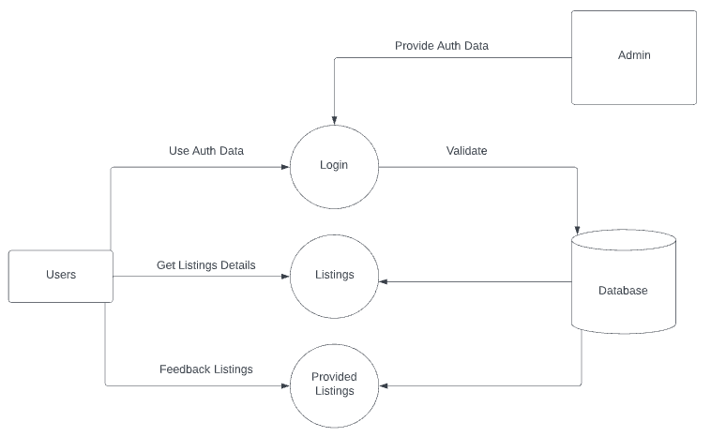
DFD LEVEL 1

Slide 14
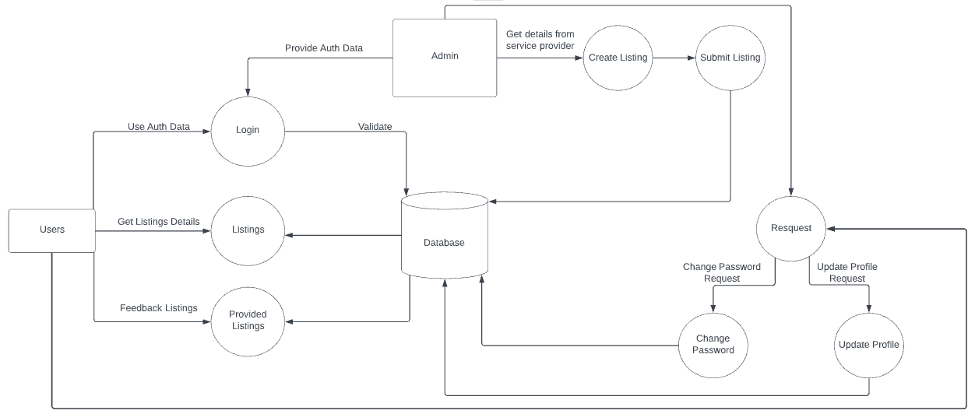
DFD LEVEL 2

Slide 15
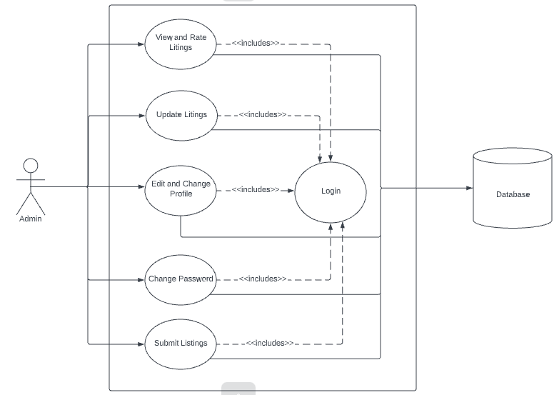
USE CASE DIAGRAM

Slide 16
Technologies Used
Frontend - HTML5, CSS3, JS with Bootstrap.
Backend - PHP, Codeigniter, MySQL.
Software Used
Visual studio Code – IDE for Development
Google Chrome – For running and testing the application.

Slide 17
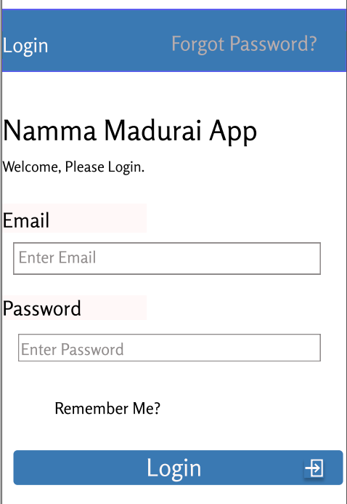
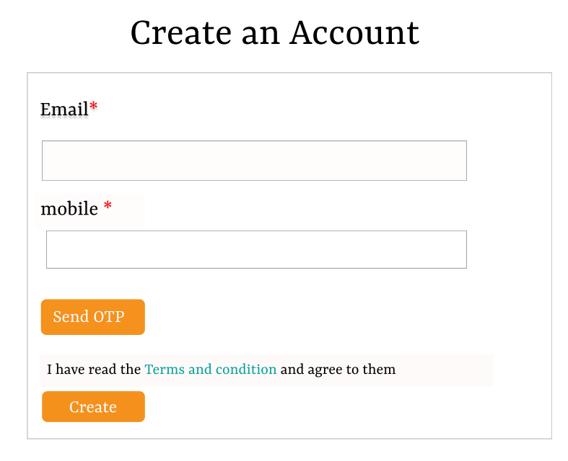
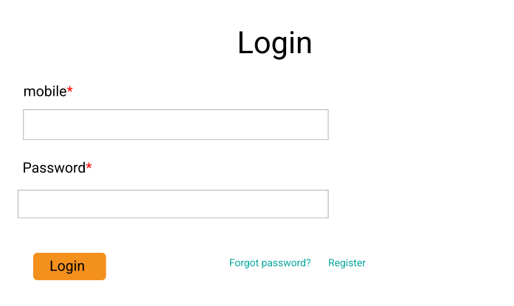
Sample Design
Admin Login
User Registration / Login

Slide 18
EXPECTED OUTCOMES
User friendly and easy to use web application to submit all the information’s like Title, Description, Logo, Address, Location, Business Details, Social Media Links, video and images needed for a place and a platform to access all the listing of places.

Slide 19
REFERENCES
https://codeigniter.com/userguide3/tutorial/index.html
https://astrowebsolution.com
https://lucid.app

